Slide 1
Time-Series Forecasting with Auto encoders
SUBMITTED BY
Jeffina J
NM ID: au711721104049
College: KGiSL INSTITUTE OF TECHNOLOGY
3/21/2024 Annual Review

Slide 2
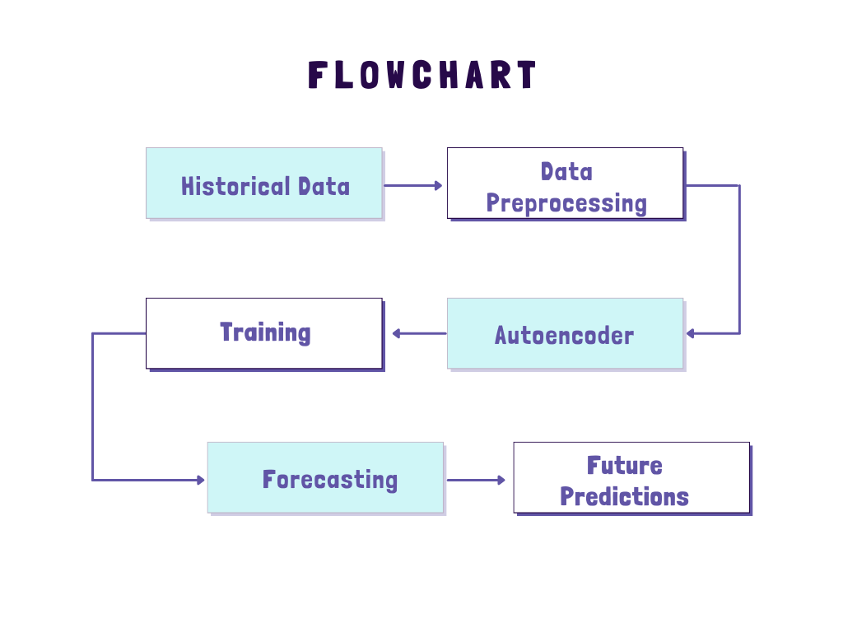
Time-Series Forecasting with Autoencoders
3/21/2024 Annual Review

Slide 3


AGENDA
PROBLEM STATEMENT
PROJECT OVERVIEW
END USERS
SOLUTION AND PROPOSITION
KEY FEATURES
MODELLING APPROACH
RESULT
3/21/2024 Annual Review

Slide 4

PROBLEM STATEMENT
The project aims to develop an autoencoder-based approach for time-series forecasting, focusing on capturing temporal dependencies and patterns within the data to generate accurate predictions of future data points.
By leveraging the power of autoencoders, the goal is to address the challenge of forecasting in dynamic and evolving time-series datasets.
3/21/2024 Annual Review

Slide 5

PROJECT OVERVIEW
This project explores the application of autoencoders in time-series forecasting, aiming to develop a model capable of capturing intricate temporal patterns within sequential data.
By encoding and decoding time-series data, the autoencoder facilitates accurate predictions of future values, offering insights into future trends and behavior.
you can systematically execute a time-series forecasting project using autoencoders, ultimately delivering a robust and effective forecasting solution tailored to your specific domain.
3/21/2024 Annual Review

Slide 6

WHO ARE THE END USERS?
Financial Analysts: Utilize the autoencoder-based time-series forecasting model to predict stock prices, currency exchange rates, or other financial metrics, aiding in investment decision-making.
Energy Sector Professionals: Employ the model to forecast energy consumption patterns, optimize energy production, and plan resource allocation for improved efficiency and sustainability.
3/21/2024 Annual Review

Slide 7

YOUR SOLUTION AND ITS VALUE PROPOSITION
The project involves generating synthetic time-series data, creating and training an autoencoder model, and evaluating its performance. The value proposition lies in the ability of the autoencoder to capture temporal patterns within the data and generate accurate predictions of future values. This solution offers insights into future trends and behavior, facilitating informed decision-making in various domains such as finance, energy, and healthcare.
3/21/2024 Annual Review

Slide 8
THE WOW IN YOUR SOLUTION
Enabling accurate forecasting of future values
Learns meaningful representations from sequential data
Better understanding
Better prediction of complex temporal dynamics
Decision making across various domains
Offers insights into future trends
Improved Accuracy, Scalability and interpretability of forecasts
3/21/2024 Annual Review

Slide 9
MODELLING
AUTOENCODER MODEL:
The autoencoder model consists of LSTM (Long Short-Term Memory) layers.
It takes a sequence of input data points and learns to encode them into a lower-dimensional representation.
The encoded representation is then decoded back to the original sequence using another set of LSTM layers.
The autoencoder is trained to minimize the mean squared error loss between the input and output sequences, effectively learning to reconstruct the input sequence.
SEQUENCE GENERATION MODEL:
After training the autoencoder, a separate function is used to generate new sequences of future data points.
This function takes a seed sequence as input and iteratively generates new data points by feeding the previous data point into the autoencoder.
The autoencoder learns to predict the next data point based on the previous ones, capturing temporal dependencies in the data.
3/21/2024 Annual Review

Slide 10
DATA GENERATION:
Synthetic time-series data is generated with two sine waves and random noise using the “generate_time_series_data” function.
2. MODEL CREATION AND TRAINING:
An autoencoder model is created using LSTM layers with specified architecture in the “create_autoencoder” function.
The autoencoder model is trained on the generated time-series data using the “train_autoencoder” function. The model is optimized to minimize the mean squared error loss between the input and output sequences.
3. SEQUENCE GENERATION:
After training the autoencoder, a new sequence of future data points is generated using the “generate_new_sequence” function.
This function takes a seed sequence and iteratively predicts future data points based on the learned patterns in the autoencoder model.
4. VISUALIZATION:
Finally, the original seed sequence and the generated future sequence are plotted for comparison using Matplotlib.

Slide 11
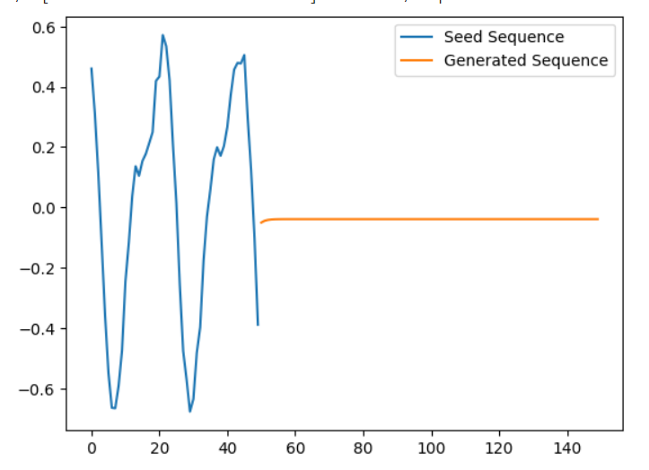
RESULTS
The project's results demonstrate the autoencoder's ability to accurately forecast future values in time-series data, showcasing its effectiveness in capturing temporal patterns and generating precise predictions.
https://drive.google.com/file/d/1E2lLc1FGSRKmYAylv0-BC-nsH2qHvzf7/view?usp=sharing
3/21/2024 Annual Review

